Slide 1
Probability + Linear Algebra
احتمال + جبر خطی

Slide 2
other slides

Slide 3
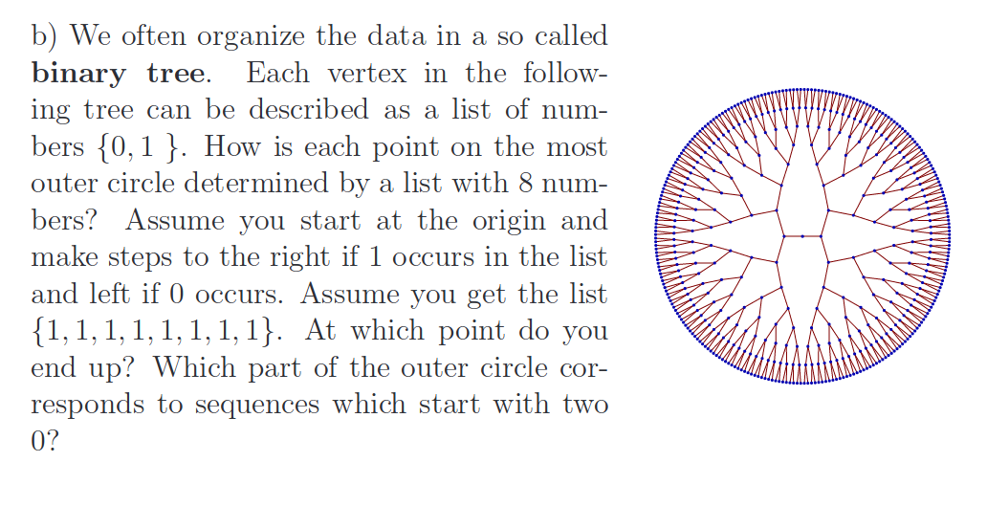

Slide 4
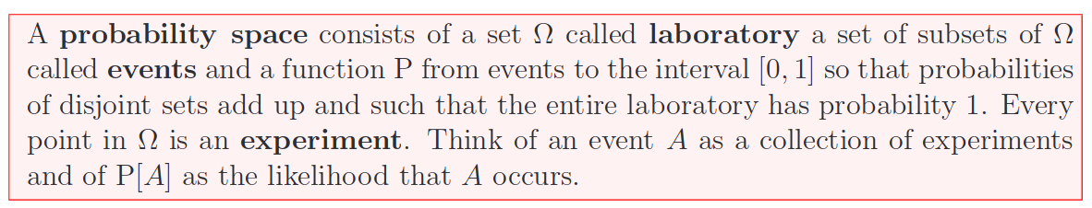
Probability

Slide 5
Random variables
hold values derived from the outcomes of random experiments. For example, random variable X holds the number of heads in flipping a coin 100 times.

Slide 6
probability distribution
A probability distribution describes the possible values and the corresponding likelihoods that a random variable can take. For example, the probabilities of having 0, 1, 2, …, 100 heads respectively.

Slide 7
Frequentist
Frequentist calculates probabilities from the relative frequencies of specific events to the total number of trials. For example, P(Head) = 0.56 if there are 56 heads out of 100 flips.

Slide 8
Bayesian
Bayesian modifies a prior belief with current experiment data using Bayesian inference. For example, a Bayesian can combine a prior belief that the coin is fair with the current experiment data (56 heads out of 100) to form a new belief (details later).

Slide 9
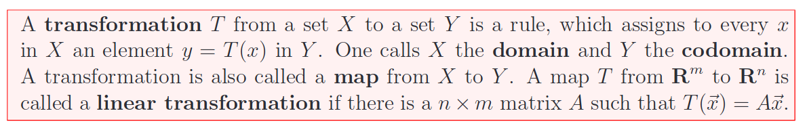
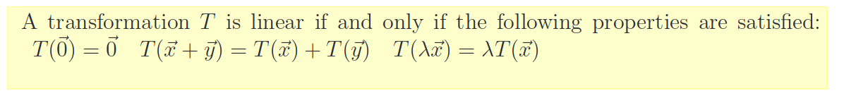
Linear transformations

Slide 10
Linear transformations are important in
geometry (i.e. rotations, dilations, projections or reflections) • art (i.e. perspective, coordinate transformations), • computer adided design applications (i.e. projections) • physics (i.e. Lorentz transformations), • dynamics (linearizations of general maps are linear maps), • compression (i.e. using Fourier transform or Wavelet transform), • error correcting codes (many codes are linear codes), • probability theory (i.e. Markov processes). • linear equations (inversion is solving the equation)

Slide 11
linear algebra enters in many different ways into data analysis. Lists and lists of lists are fundamental ways to represent data. They will be called vectors and matrices. Linear algebra is needed to find good models or to reduce data. Finally, even if we have a model, we want to do computations efficiently

Slide 12
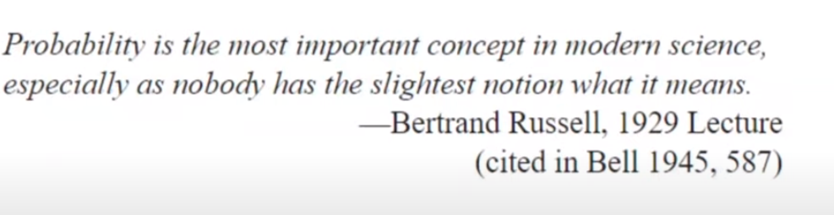

Slide 13
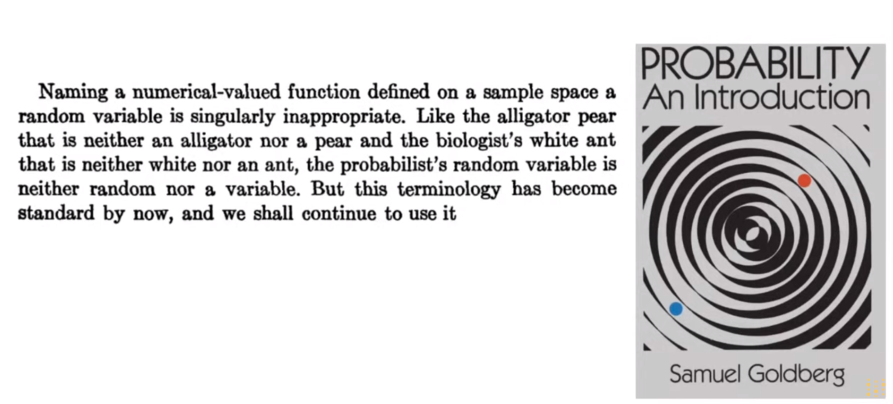

Slide 14
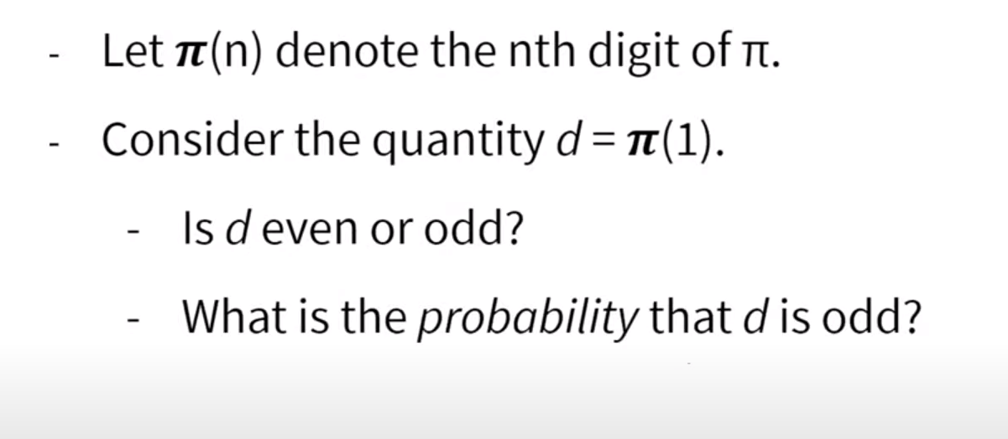

Slide 15
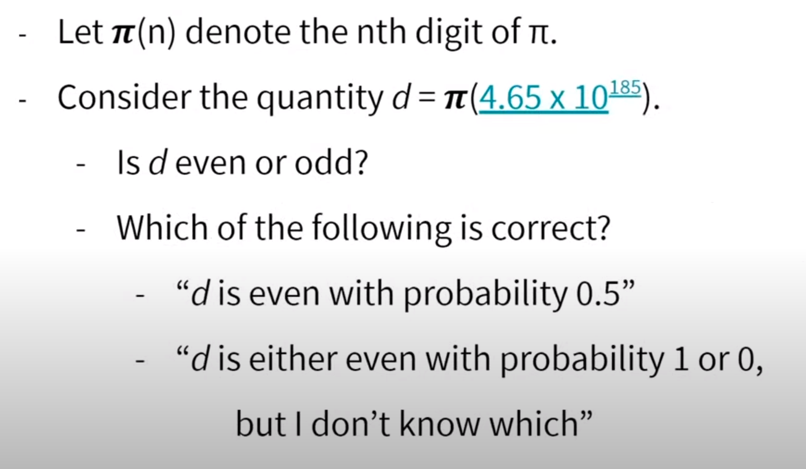

Slide 16
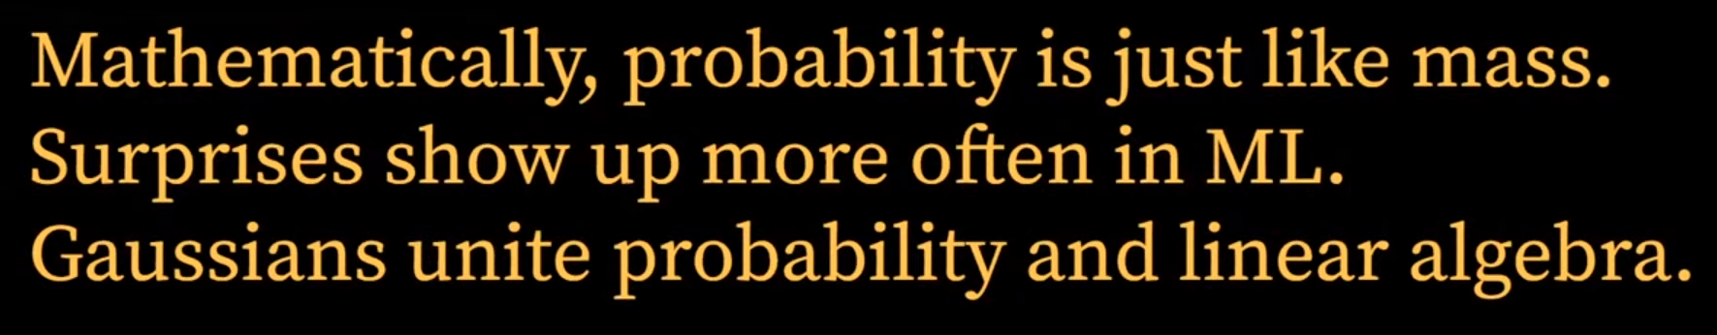

Slide 17
